Slide 1

American sign language (ASL) to text conversion using CNN
Capstone Project Phase 1 - 23-2-D-4
Supervisor:
Miri Weiss Cohen
Submates:
Michael Ohayon
Ido Mialy
Page 1 of 23

Slide 2
Table of contents
01
Problem Motivation
02
03
DenseNet
Convolutional neural network
Transfer Learning
04
YOLOv5
05
06
Dataset
07
Research Product
09
Evaluation/Verification Plan
Experiments
08
Page 2 of 23

Slide 3
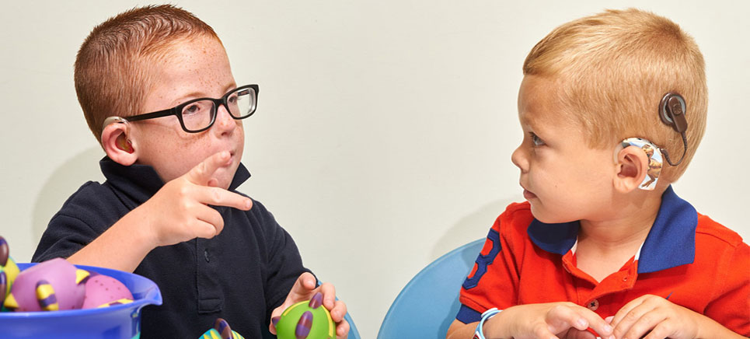
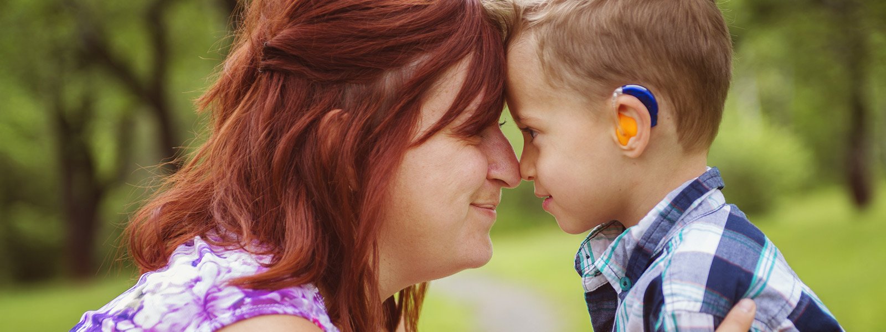
Problem
01
According to the World Health Organization (WHO), approximately 70 million hearing-impaired and deaf individuals worldwide use sign language for communication. In the United States alone, 500,000 hearing-impaired and deaf individuals rely on American Sign Language (ASL) for communication.
Page 3 of 23

Slide 4
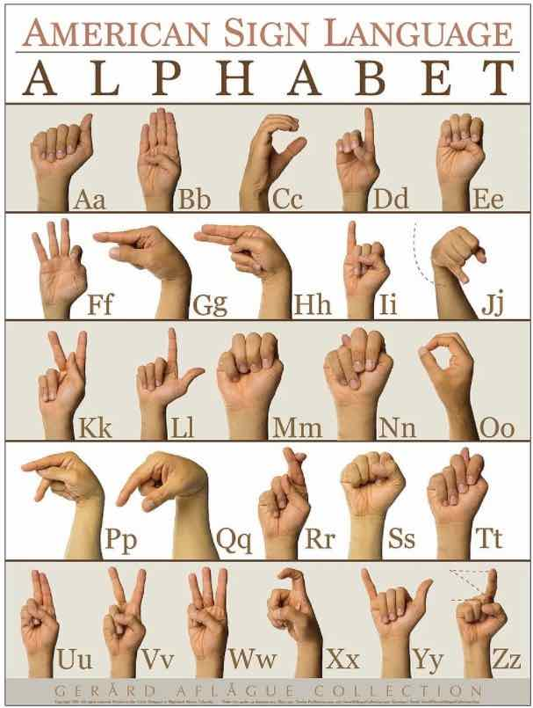
American Sign Language (ASL)
Problem
01
ASL is a complete, natural language used by the Deaf community in the world. One fundamental aspect of ASL is its system of letters, which correspond to the alphabet in spoken languages.
Each letter in ASL is expressed through unique handshapes and movements.
Page 4 of 23

Slide 5
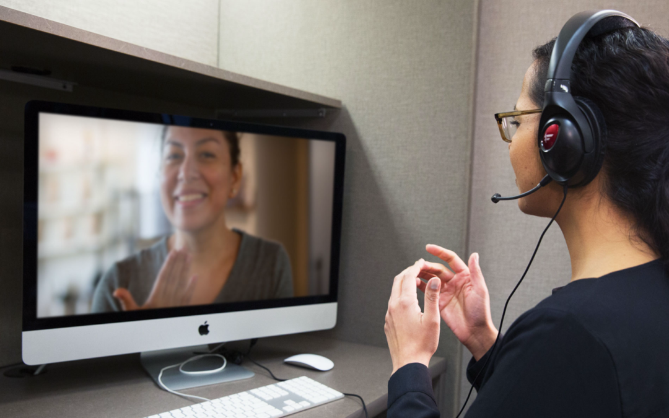
Motivation
01
ASL users and hearing people face a big communication barrier. This makes it hard to understand each other, limits social inclusion, and hampers equal participation in life.
We want to Overcoming this communication barrier for a better world!
Page 5 of 23

Slide 6
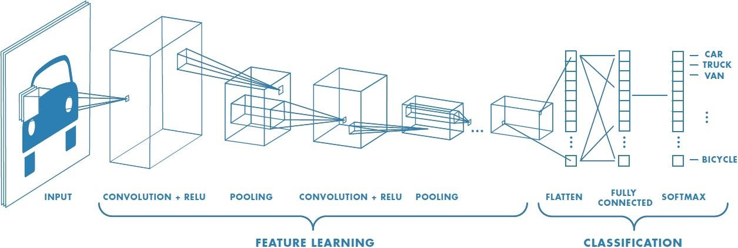
Convolutional neural network
02
A Convolutional Neural Network (CNN) is a deep learning model for visual data analysis. It automatically learns features from 2D images, enabling tasks like classification and detection.
A CNN structure includes:
Input Layer
Convolutional Layers
Activation Function
Pooling Layers
Fully Connected Layers
Output Layer
Page 6 of 23

Slide 7
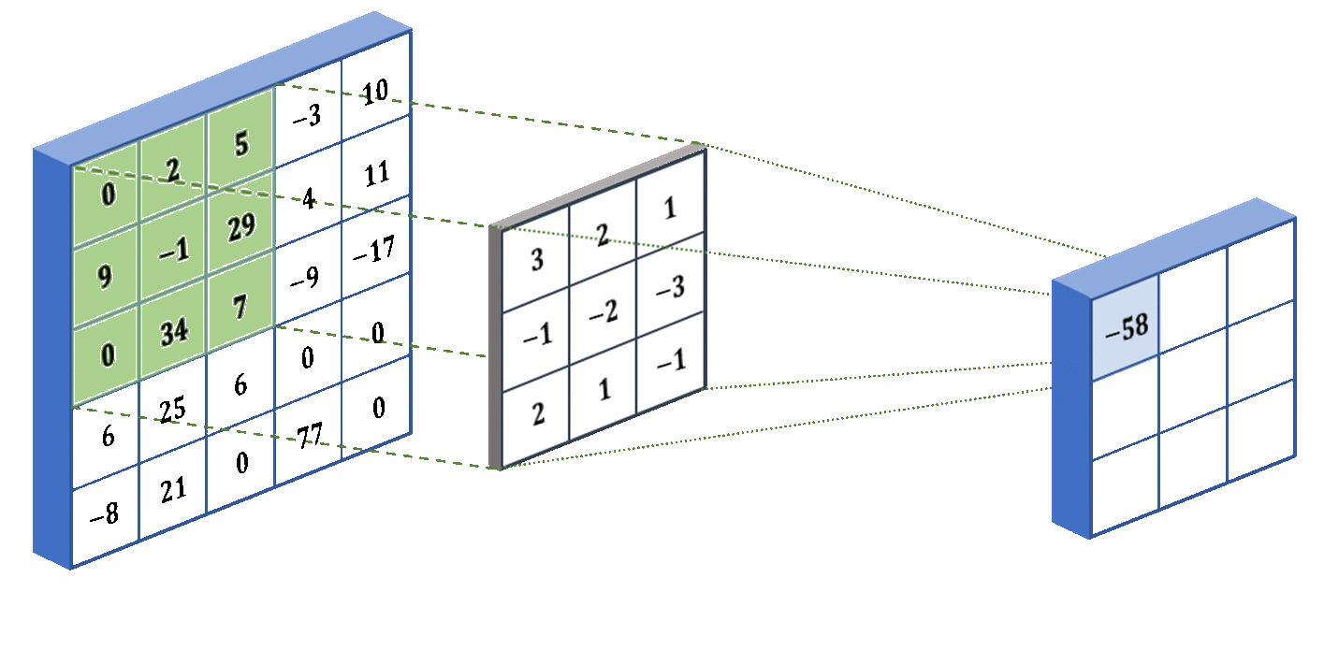
Convolutional neural network
02
Convolutional Layer
These layers perform convolutions on the input image using learnable filters or kernels. Each filter slides over the input, extracting local features and creating feature maps.
Page 7 of 23

Slide 8
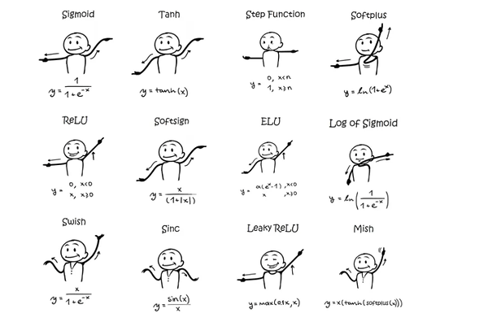
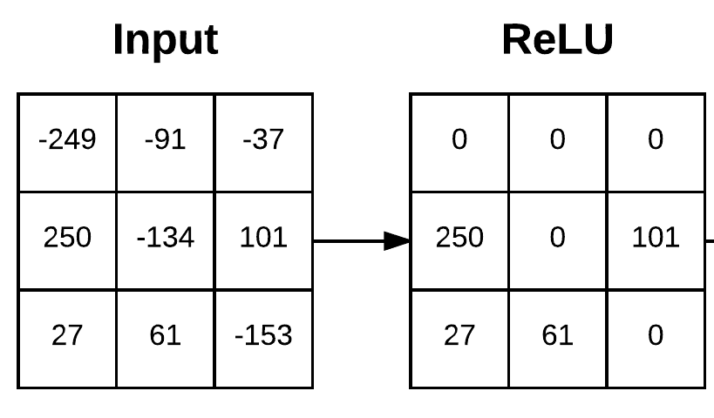
Convolutional neural network
02
Activation Function
The convolution layer output is passed through a non-linear activation function, introducing non-linearity and enabling the network to learn complex patterns. The activation function determines neuron activation, controlling information flow to the next layer.
Page 8 of 23

Slide 9
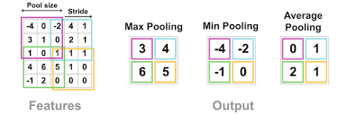
Convolutional neural network
02
Pooling Layer
Pooling layer downsample feature maps by reducing their size. This helps reduce computational complexity and retain important information.
Page 9 of 23

Slide 10
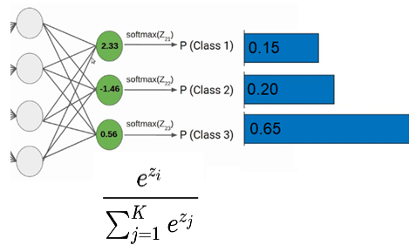
Convolutional neural network
02
Fully Connected Layer
Towards the end of the network, fully connected layers are used to connect all the neurons from the previous layers to the final output layer. They learn high-level representations and make predictions based on the extracted features.
Page 10 of 23

Slide 11
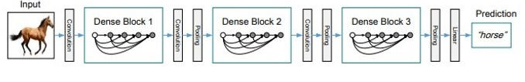
DenseNet
03
DenseNet is a deep neural network architecture that connects each layer to every other layer in a feed-forward fashion, enabling efficient feature reuse.
In DenseNet, each layer receives input from all preceding layers, creating a dense block of interconnected layers.
Page 11 of 23

Slide 12
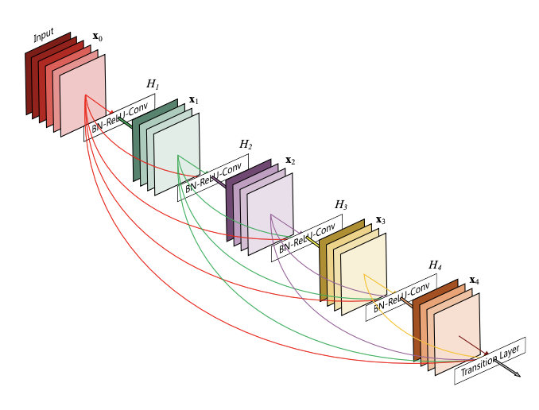
DenseNet
03
The Dense block consists of batch normalization, ReLU activation, and convolutional layers. The number of filters remains constant to control parameters.
Page 12 of 23

Slide 13
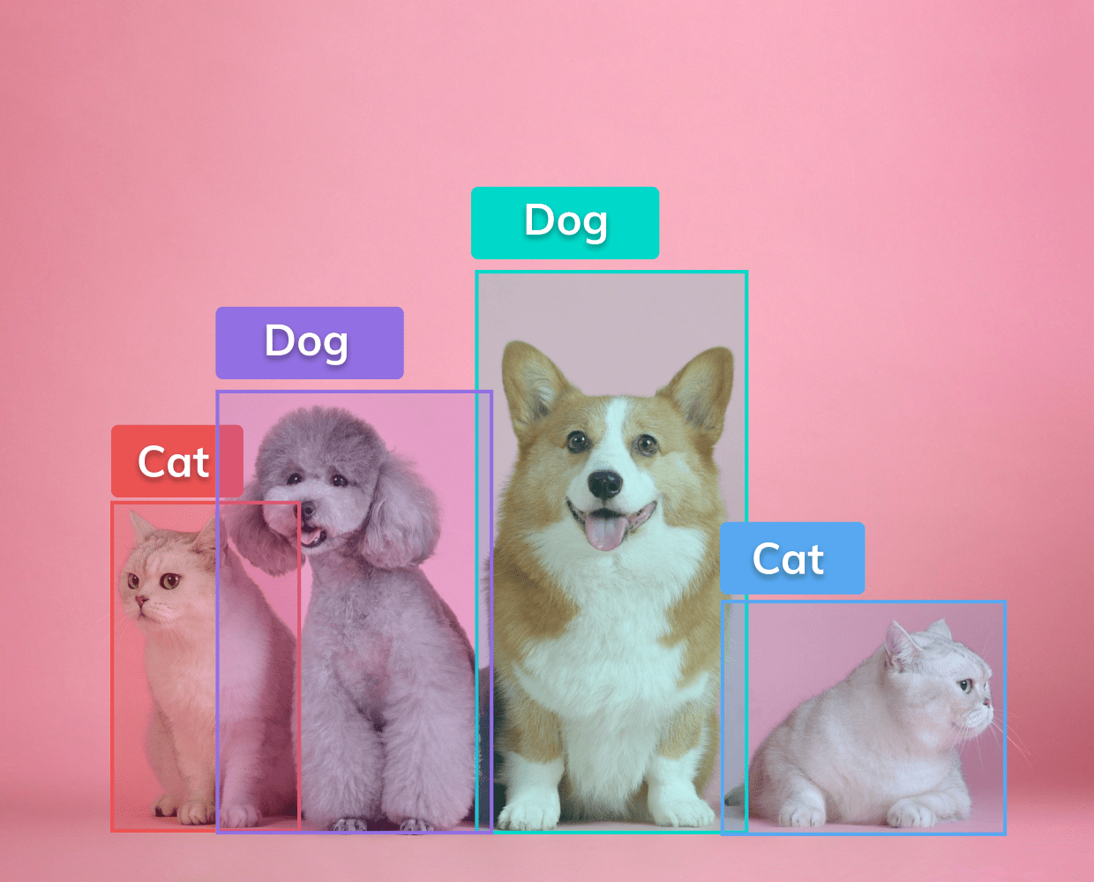
YOLOv5
04
YOLO - “YOU ONLY LOOK ONCE” is an algorithm that uses neural networks to provide real-time object detection.
YOLO combines object localization and classification to detect and locate objects in an image.
Page 13 of 23

Slide 14
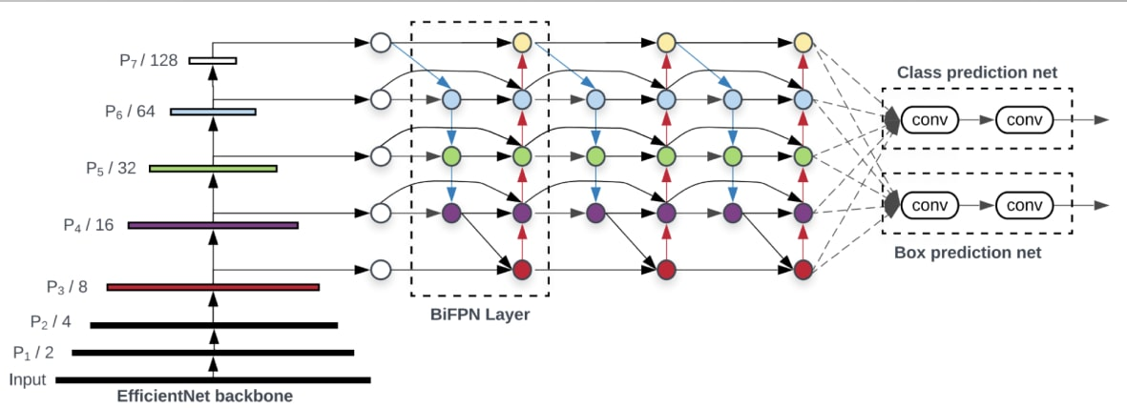
YOLOv5
04
The YOLO network has three main components: 1. Backbone - aggregates image features 2. Neck - mixes and combines features 3. Head - generates box and class predictions
Page 14 of 23

Slide 15
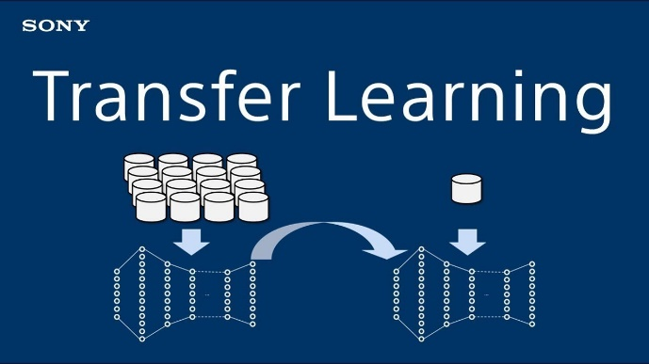
Transfer Learning
05
Transfer learning is a technique in machine learning where a pre-trained model is used as a starting point to solve a new problem. The model has already learned valuable features from a large dataset which can be applied to the new task.
Page 15 of 23

Slide 16
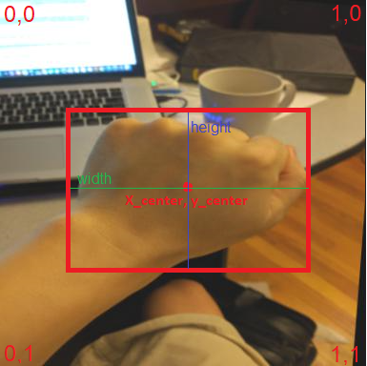
Dataset
06
To train our model we used the "American Sign Language Letters Dataset" (ASL-DS) obtained from roboflow. The dataset consists of 1728 images of letters annotated in YOLOv5 PyTorch format.
<class> <x_center> <y_center> <width> <height>
The dataset was divided into three parts: train (1512 images), valid (144 images), and test (72 images).
Page 16 of 23

Slide 17
Experiment
07
Hyperparameters
1. Learning Rate(LR) - using the values: (0.000001, 0.00001, 0.0001)
2. Epochs - check sizes of 50 to 100.
3. Batch Size - check sizes of 8 to 32 .
4. Loss function – we will use cross-entropy function and Adam optimizer.
5. Dropouts – check probability of an element to be zeroed of 0.2 to 0.5
Page 17 of 23

Slide 18
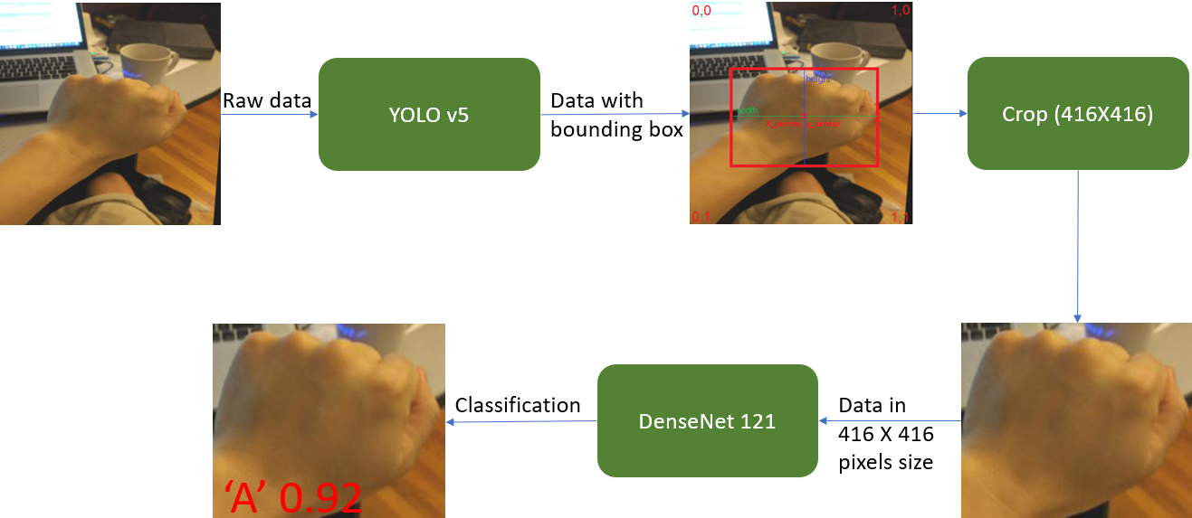
Research Product
08
Flow Chart
Page 19 of 23

Slide 19
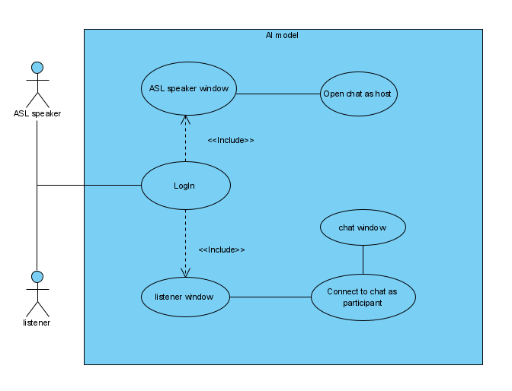
Research Product
08
Use Case
Page 18 of 23

Slide 20
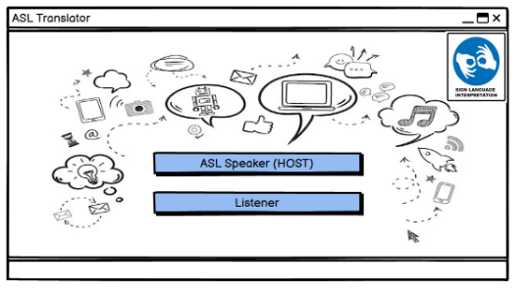
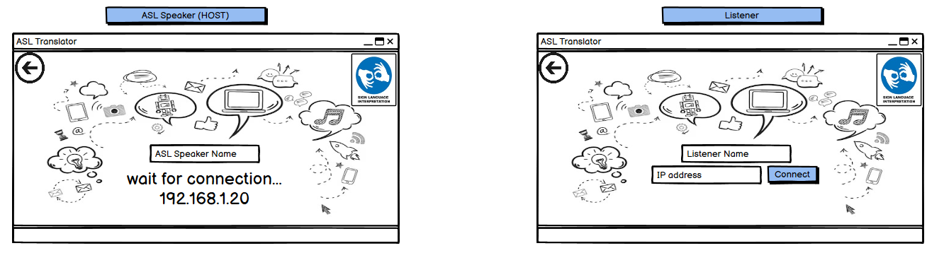
Research Product
08
GUI
Page 20 of 23

Slide 21
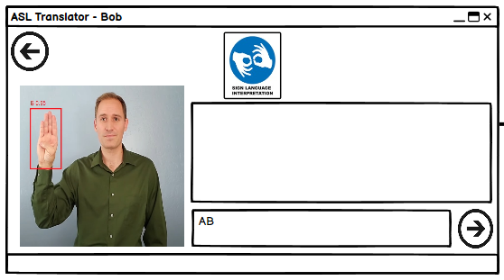
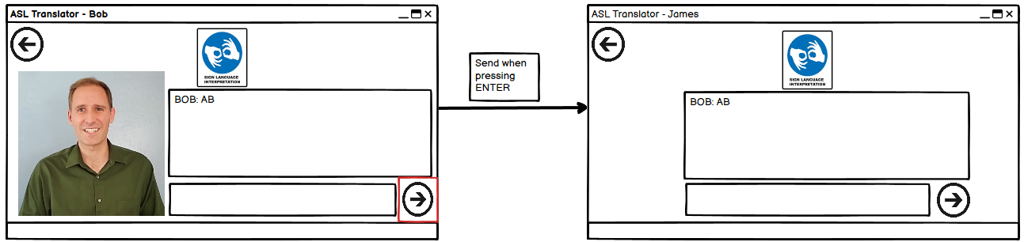
Research Product
08
GUI
Page 21 of 23

Slide 22
Evaluation Verification Plan
09
CASE | Test explanation | Expected result
1.Home Page
1.1 | Press on “ASL SPEAKER” button | Open new window calls “waiting for connection”
1.2 | Press on “LISTENER” button | Open new window calls “Connect via IP”
2.1. ASL Speaker Login
2.1.1 | Press “Return " button | Return to Home page
2.2. Listener Login
2.2.1 | Press “Return " button | Return to Home page
2.2.3 | Press connected without filling IP textbox | Throws error: “Type Valid IP”
2.2.4 | Press connected with not valid IP | Throws error: “IP not valid, try again”
2.2.5 | Press connected with valid IP | For the listener opens that listener chat window For the ASL Speaker: opens that the ASL Speaker chat window
3. Chat window
3.1. | Recognize letter from ASL speaker at least 3 seconds | The letter will be written in his personal chat box
3.2 | Press “Send” button | Send the text in the personal section to the other side, and update the public chat box
3.3 | Press “Return " button | Return to login window for both ASL speaker and listener
4. General
4.1 | Press “X" button from every window | Exit program
Page 22 of 23

Slide 23
Thank you!
Michael Ohayon Ido Mialy
Page 23 of 23

